Slide 1
1. Harshitha Gorjala Subramanayam
2. Boddoju Venkata Naga Sai Priyanka
3. Ifra Naaz Mohammed
4. Gowtham Reddy Gurrala
Date: 21-04-2024
Project Name: Streamlining COVID-19 Data Analysis with AWS
DSCI 6007-Final Project – Showcase

Slide 2

Streamlining COVID-19 Data Analysis with AWS
Our DSCI 6007-Final Project Showcase presents a solution that leverages Amazon Web Services (AWS) to empower data analysts, public health officials, and decision-makers with the tools and insights necessary to navigate the COVID-19 pandemic effectively.

Slide 3
Business Scenario Overview
1
Problem Statement
2
Proposed Solution
The COVID-19 pandemic has created challenges in consolidating and analyzing data from various sources, hindering decision-making.
This project aims to develop a comprehensive data pipeline using cloud-based technologies to aggregate and transform COVID-19 data for efficient analysis.
3
Key Objectives
The project's objectives are to establish a robust data pipeline, ensure data integrity, develop a centralized data warehouse, derive meaningful insights, and provide a user-friendly platform for data access.

Slide 4

Solution Overview
Our comprehensive solution streamlines COVID-19 data integration, analysis, and decision-making. It consolidates diverse data sources into a scalable, cloud-native platform powered by AWS. With a robust data pipeline, we efficiently process and analyze data using AWS Glue, and Amazon Athena. Stakeholders gain actionable insights through interactive dashboards, empowering evidence-based policies. Our secure, flexible, and scalable platform transforms raw data into actionable intelligence, enabling confident navigation of pandemic challenges.

Slide 5
Design Considerations
1
Scalability
2
Flexibility
3
Data Quality
Our solution handles diverse data sources and rapidly growing volumes by leveraging scalable cloud infrastructure and flexible data integration techniques. This ensures seamless adaptation to changing data requirements without compromising performance or reliability.
Our solution seamlessly integrates a wide range of data formats and structures, allowing us to ingest and process data from multiple sources without extensive manual intervention or data normalization efforts.
We maintain the highest standards of data quality and trustworthiness through rigorous validation, cleansing procedures, and advanced transformation techniques.
4
Security
5
Automation
We prioritize robust data security measures to protect the confidentiality and integrity of sensitive COVID-19 data, ensuring strict adherence to relevant data privacy regulations.
Our solution leverages automated workflows and processes throughout the data pipeline, enhancing efficiency and reducing manual effort.

Slide 6
Use Cases
Epidemiological Analysis Track virus spread, identify hotspots, and optimize resource allocation for proactive containment strategies.
Public Health Policy Formulate evidence-based interventions and healthcare strategies to prioritize community well-being.
Clinical Research Accelerate scientific understanding, optimize clinical trials, and facilitate the development of treatments and vaccines.
Community Engagement Promote transparency, empower citizens, and foster a collaborative approach to pandemic response efforts.
Our solution equips decision-makers, public health professionals, and the broader community with comprehensive tools and insights to navigate the complexities of the pandemic and effectively mitigate its impact.

Slide 7




Services Used
Amazon S3
AWS Glue
Amazon Sagemaker
Amazon Athena
Amazon S3 is the foundational data repository for our COVID-19 data pipeline, providing secure and scalable storage for diverse data sources.
Powers ETL processes by seamlessly extracting, transforming, and loading data into our centralized warehouse for analysis.
Amazon SageMaker uses Jupyter notebooks for interactive data analysis and model development, enhancing productivity and collaboration in machine learning workflows.
Enables flexible and serverless data analysis for COVID-19 data through ad-hoc SQL queries and insightful reporting, complementing our data warehouse.

Slide 8
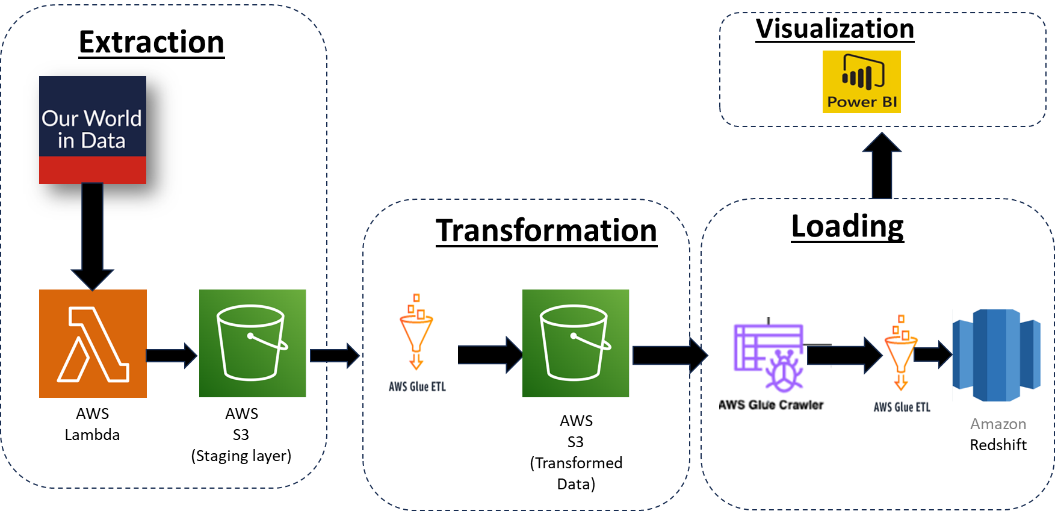
Architecture Diagram of the Solution

Slide 9
Lessons Learned
Robust Integration
1
Successfully managed diverse data formats and sources
Rigorous Validation
2
Ensured data quality through rigorous validation procedures
Scalable Design
3
Optimized scalability while handling large data volumes
During the development of our COVID-19 data analysis solution, we addressed critical challenges. Firstly, we integrated diverse data formats and sources seamlessly. Secondly, we ensured data integrity and accuracy through rigorous validation procedures. Finally, we optimized scalability to handle large data volumes effectively. Leveraging online resources, AWS documentation, and collaborations with domain experts, we created a robust, scalable, and reliable system for COVID-19 data analysis.

Slide 10
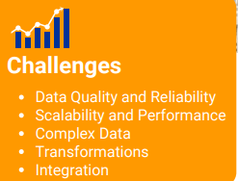
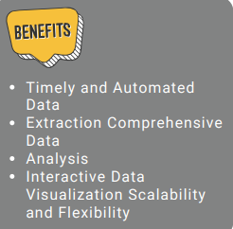

Slide 11
Conclusion
This task provides an efficient solution for extracting and analyzing the COVID-19 dataset, leading to valuable insights. By automating data extraction, transforming it into structured tables, and loading it into a centralized database, we enable comprehensive analysis of key parameters.
The visualization component facilitates the generation of informative reports. This project helps individuals by providing timely and accurate information on COVID-19 trends, enabling informed decision-making, and supporting proactive measures to protect their health and well-being.
It empowers individuals with a deeper understanding of the pandemic's impact, facilitating personal risk assessment and the adoption of appropriate preventive measures.

Slide 12
Next Steps and Key Takeaways
New Skills Developed
1
Through this project, our team mastered data wrangling, cloud-based warehousing, and advanced visualization, converting raw COVID-19 data into actionable insights. This expertise readies us for future data challenges.
2
Expanding Data Sources
Our next step is to broaden our COVID-19 data sources by integrating demographic, socioeconomic, and public health indicators. This comprehensive approach will enhance our understanding of the pandemic's impact and guide targeted interventions.
Refining Analytical Models
3
We'll refine our analytical models by experimenting with various algorithms, techniques, and expert feedback to enhance accuracy and predictive capabilities. This ensures more reliable projections for public health decision-making.
4
Enhancing Visualization
We'll enhance COVID-19 data visualization by creating intuitive, interactive dashboards with advanced charting and mapping tools. Incorporating user feedback ensures clear and compelling insights for informed discussions on pandemic response strategies.
Sharing Findings
5
We'll share our findings and best practices with the scientific community, fostering collaboration and advancing understanding of the COVID-19 pandemic. This promotes transparency and supports coordinated global efforts in addressing current and future health crises.

Slide 13


